Slide 1
Lecture 1.2 Decision making under risk

Slide 2
Decision making under risk
A fundamental question in economics is how people respond to a choice involving a risky prospect.
We usually think about agents maximizing expected utility.
Most people are risk averse compared with being risk loving. They prefer less risk or uncertainty.
More precisely:
a risk averse person will prefer a sure thing to a risky alternative with the same expected (average) value
a risk averse person has a concave utility function

Slide 3
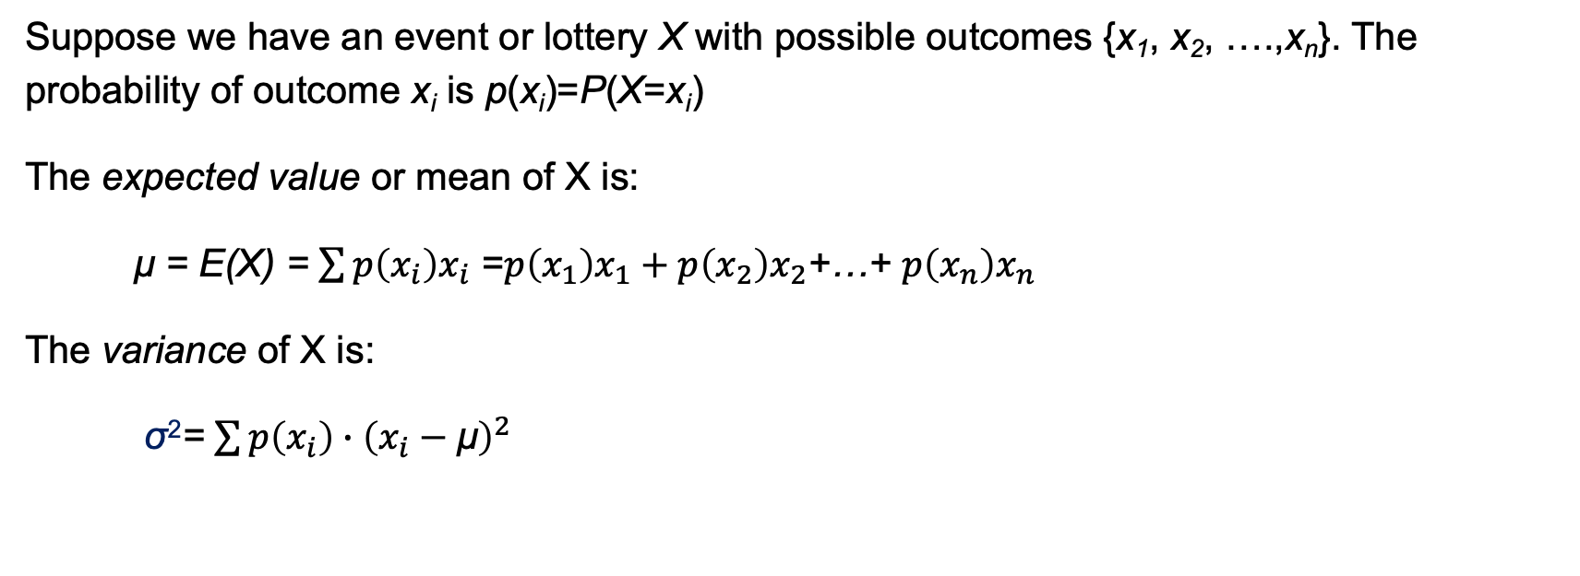
Decision making under risk
Suppose we have an event or lottery X with possible outcomes {x₁, x₂, ….,x_{n}}. The probability of outcome x_{i} is p(x_{i})=P(X=x_{i})
The expected value or mean of X is:
μ = E(X) = $\sum{p\left(x_{i}\right)x_{i}}$ =$p\left(x_{1}\right)x_{1}+p\left(x_{2}\right)x_{2}$+…+ $p\left(x_{n}\right)x_{n}$
The variance of X is:
σ²= $\sum{p\left(x_{i}\right)∙{\left(x_{i}−\text{μ}\right)}^{2}}$

Slide 4
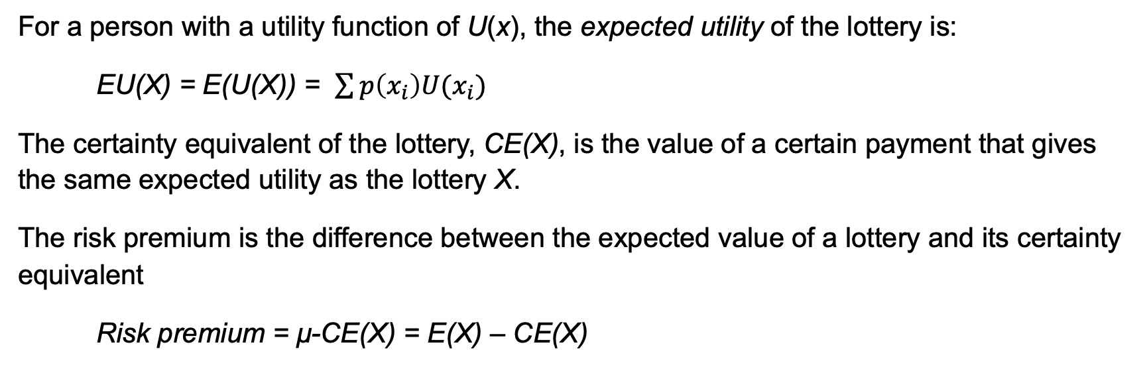
Decision making under risk
For a person with a utility function of U(x), the expected utility of the lottery is:
EU(X) = E(U(X)) = $\sum{p\left(x_{i}\right)U(x_{i})}$
The certainty equivalent of the lottery, CE(X), is the value of a certain payment that gives the same expected utility as the lottery X.
The risk premium is the difference between the expected value of a lottery and its certainty equivalent
Risk premium = μ-CE(X) = E(X) – CE(X)

Slide 5
Decision making under risk
Consider someone who faces a choice between two different payment schemes.
Salary = $80,000; σ=0. Expected value = $80,000.
Salary + performance bonus with σ=81,650. Expected value = $100,000.
What are they indifferent between them? What does this look like?
We will look at this in two different ways:
With indifference curves
With the utility function (although using a simpler salary structure)

Slide 6
Decision making under risk
μ=E(X)
Direction utility
0
σ (in dollars)
0

Slide 7
Decision making under risk
μ=E(X)
Direction utility
100,000
80,000
0
σ (in dollars)
0
81,650

Slide 8
Decision making under risk
μ=E(X)
Direction utility
100,000
80,000
Risk premium = $20,000
0
σ (in dollars)
0
81,650

Slide 9
Decision making under risk
Consider someone who faces is offered a job with the following payment scheme.
If they have a good year and sell many houses (50% of the time) their salary = $100,000.
If they have a bad year and sell nothing (the other 50%) their salary = $0.
The expected value is $50,000.

Slide 10
Decision making under risk
U(x)
0
0
x

Slide 11
Decision making under risk
U(x)
U(100)
U(50)
0
0
50,000
100,000
x

Slide 12
Decision making under risk
U(x)
U(100)
U(50)
EU
0
0
50,000
100,000
x

Slide 13
Decision making under risk
U(x)
U(100)
U(50)
EU
Risk premium
0
CE(x)
0
50,000
100,000
x

